Slide 1

50.039 Theory and Practice of Deep Learning W4-S2 Introduction to Computer Vision and Convolutional Neural Networks
Matthieu De Mari

Slide 2
About this week (Week 4)
What are images and how is this datatype represented?
What is a pixel and how can its information be interpreted?
What is the spatial dependence property of pixels?
What is the homophily property of pixels?
Why is the linear processing operation failing on images?
What is the convolution operation?
How can we perform image processing using convolutions?
What is padding in convolutions?

Slide 3
About this week (Week 4)
What is stride in convolution?
What is dilation in convolution?
How does convolution apply to higher dimensional images?
How to write our own convolutional processing layer in PyTorch?
What is Conv2d in PyTorch?
What is a Convolutional Neural Network (CNN)?
What is the intuition behind using Convolutional layers in a Convolutional Neural Network?

Slide 4
About this week (Week 4)
How to train our first Convolutional Neural Network on MNIST?
What are other typical image processing layers in Computer Vision and how are they implemented?
What is the pooling layer?
What is the batchnorm layer?
What is the dropout layer?
What is data augmentation in Computer Vision?
What are some milestone Computer Vision models and their contributions to the field of Deep Learning?

Slide 5
About this week (Week 4)
What are the AlexNet and VGG models?
What is a skip connection/residual? What is its effect on a Neural Network and how does it help with vanishing gradient problems?
What are ResNet and DenseNet models?
What is the Inception model?
What is the EfficientNet model?
What is transfer learning and its uses?
How to freeze and fine-tune layers in a Neural Network?

Slide 6
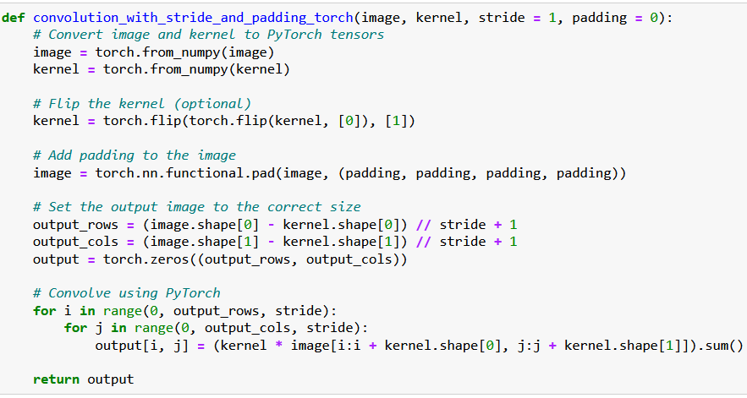
Implementing a custom Conv in PyTorch

Slide 7
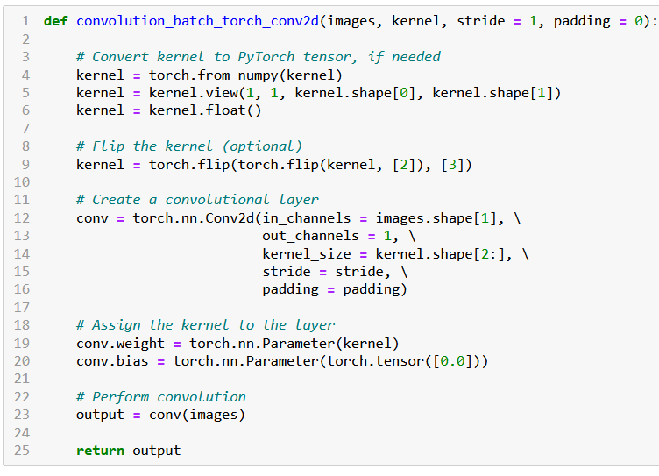
The Conv2d in PyTorch
PyTorch has a Conv2d function implementing said convolution.
We will rely on it from now on.

Slide 8
The Conv2d in PyTorch
Note, however that this layer has two trainable parameters:
Weight (which is our kernel, whose values will be decided later during training).
Bias (which was not there before?)

Slide 9
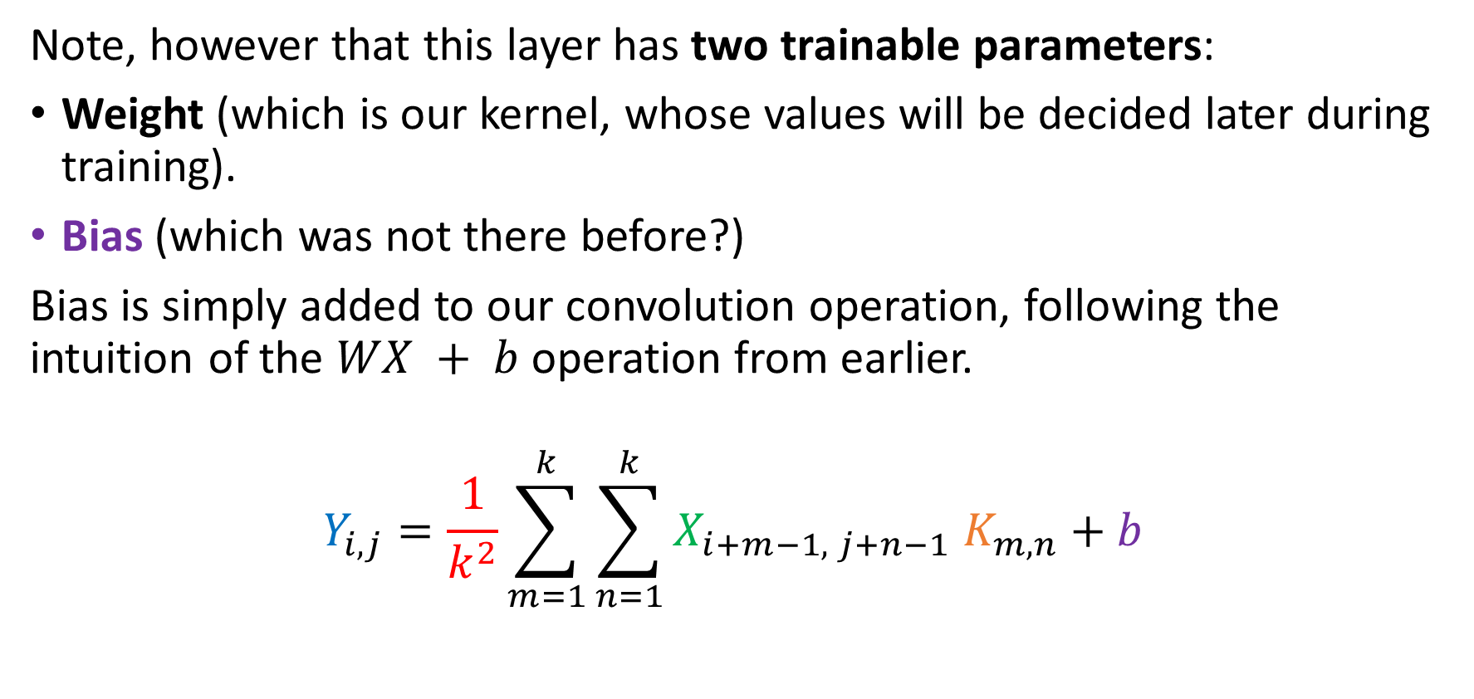
The Conv2d in PyTorch
Note, however that this layer has two trainable parameters:
Weight (which is our kernel, whose values will be decided later during training).
Bias (which was not there before?)
Bias is simply added to our convolution operation, following the intuition of the $WX + b$operation from earlier.
$$Y_{i,j}=\frac{1}{k^{2}}\sum_{m=1}^{k}{\sum_{n=1}^{k}{X_{i+m−1, j+n−1} K_{m,n}}}+b$$

Slide 10
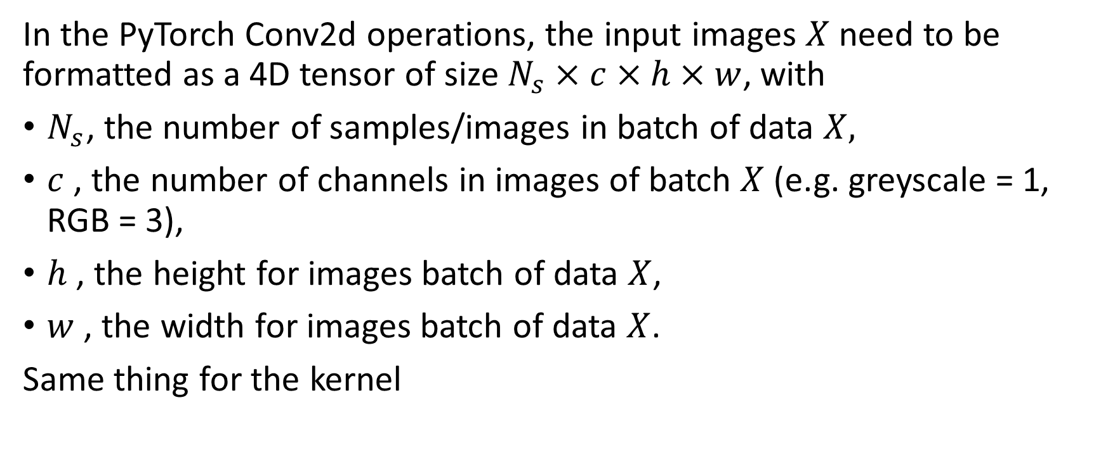
The Conv2d in PyTorch
In the PyTorch Conv2d operations, the input images $X$ need to be formatted as a 4D tensor of size $N_{s}×c×h×w$, with
$N_{s}$, the number of samples/images in batch of data $X$,
$c$ , the number of channels in images of batch $X$ (e.g. greyscale = 1, RGB = 3),
$h$ , the height for images batch of data $X$,
$w$ , the width for images batch of data $X$.
Same thing for the kernel

Slide 11
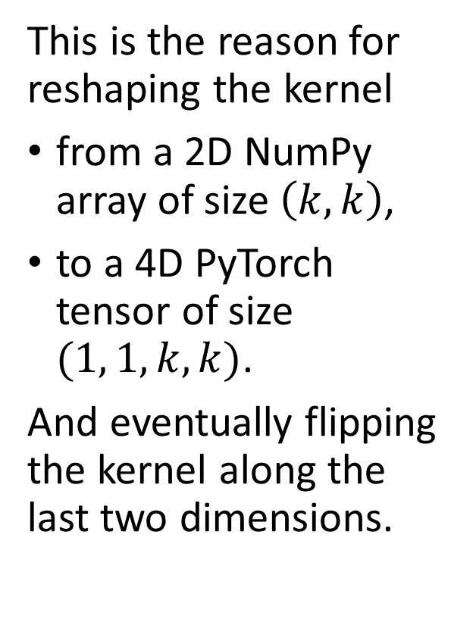
The Conv2d in PyTorch
This is the reason for reshaping the kernel
from a 2D NumPy array of size $\left(k, k\right)$,
to a 4D PyTorch tensor of size $(1, 1, k, k)$.
And eventually flipping the kernel along the last two dimensions.

Slide 12
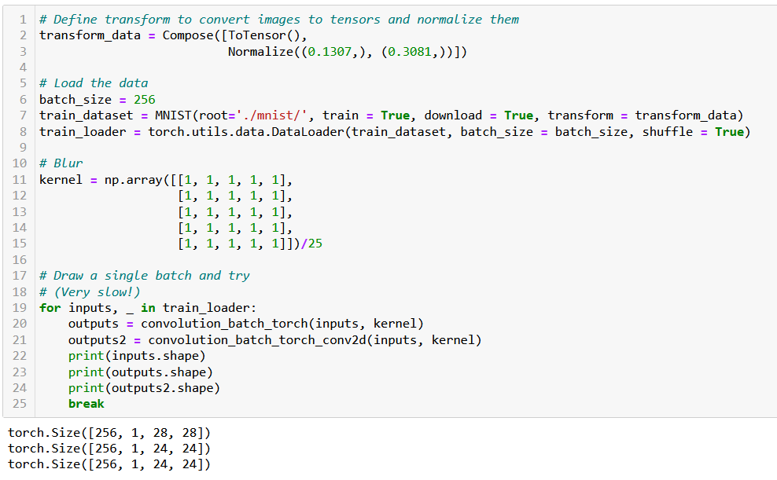
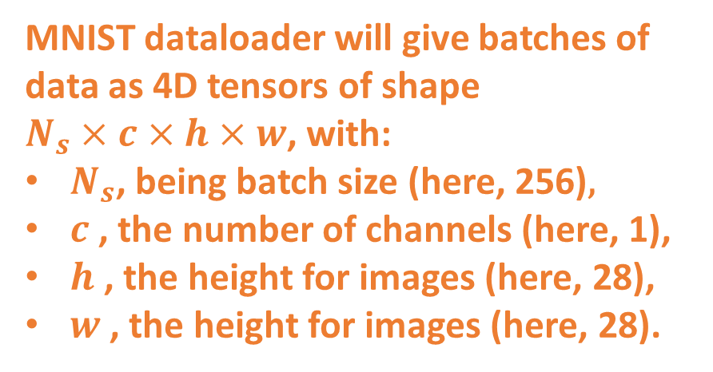
If we use the MNIST dataloader…
MNIST dataloader will give batches of data as 4D tensors of shape $N_{s}×c×h×w$, with:
$N_{s}$, being batch size (here, 256),
$c$ , the number of channels (here, 1),
$h$ , the height for images (here, 28),
$w$ , the height for images (here, 28).

Slide 13

If we use the MNIST dataloader…
Not using a padding, stride 1, and kernel size is 5.
Our magic formula from earlier then gives:
$$28+ 2×0−5+1=24.$$

Slide 14
A quick word on higher dimensions
So far, we have implemented the convolution operation on images that were greyscale (either our flower image or the MNIST dataset).
What happens when playing with higher dimension images, i.e. images that have more than one channel (e.g. RGB)?

Slide 15
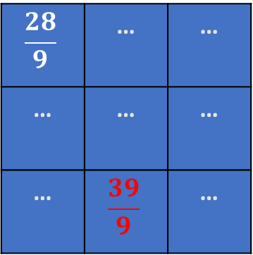

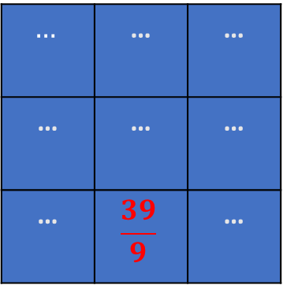

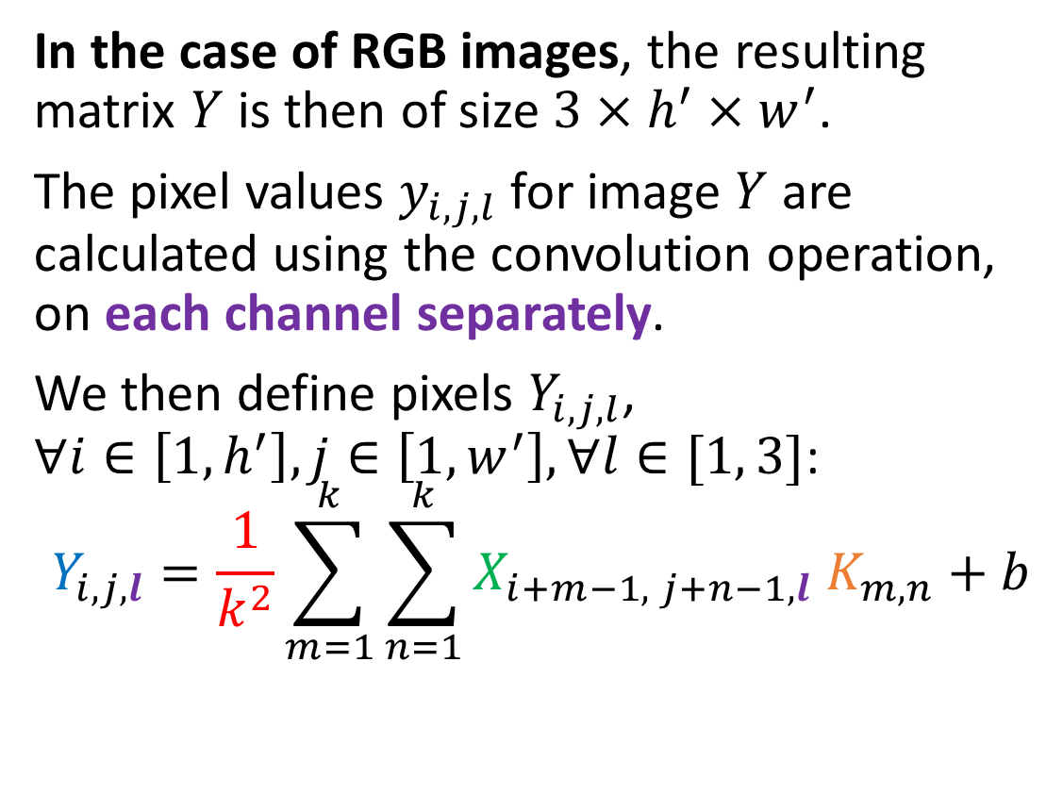

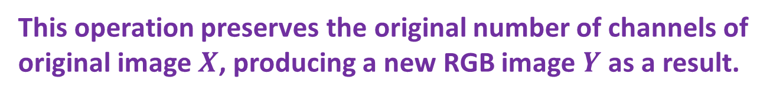
Convolution on high dim
1 | 2 | 4 | 2 | 1
4 | 7 | 3 | 2 | 1
4 | 5 | 2 | 3 | 1
2 | 1 | 7 | 8 | 4
3 | 2 | 4 | 7 | 8
1 | 2 | 4 | 2 | 1
4 | 7 | 3 | 2 | 1
4 | 5 | 2 | 3 | 1
2 | 1 | 7 | 8 | 4
3 | 2 | 4 | 7 | 8
1 | 2 | 4 | 2 | 1
4 | 7 | 3 | 2 | 1
4 | 5 | 2 | 3 | 1
2 | 1 | 7 | 8 | 4
3 | 2 | 4 | 7 | 8
$$X$$
In the case of RGB images, the resulting matrix $Y$ is then of size $3×h^{′}×w^{′}$.
The pixel values $y_{i,j, l}$for image $Y$ are calculated using the convolution operation, on each channel separately.
We then define pixels $Y_{i,j,l}$, $∀i∈\left[1, h^{′}\right], j∈\left[1,w^{′}\right], ∀l∈[1, 3]$:
$$Y_{i,j,l}=\frac{1}{k^{2}}\sum_{m=1}^{k}{\sum_{n=1}^{k}{X_{i+m−1, j+n−1,l} K_{m,n}}}+b$$
1 | 0 | 1
0 | 2 | 1
1 | 0 | 1
$$K$$
$$…$$ | … | …
… | … | …
… | $$\frac{39}{9}$$ | …
$$…$$ | … | …
… | … | …
… | $$\frac{39}{9}$$ | …
$$Y$$
$$\frac{28}{9}$$ | … | …
… | … | …
… | $$\frac{39}{9}$$ | …
This operation preserves the original number of channels of original image $X$, producing a new RGB image $Y$ as a result.

Slide 16

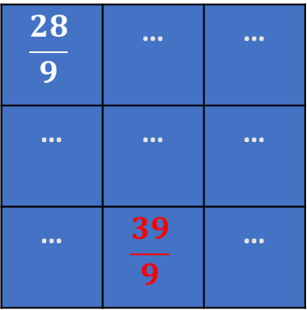

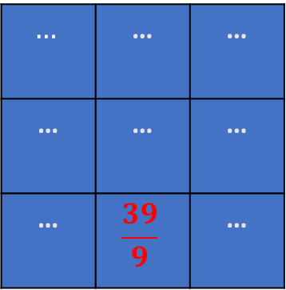
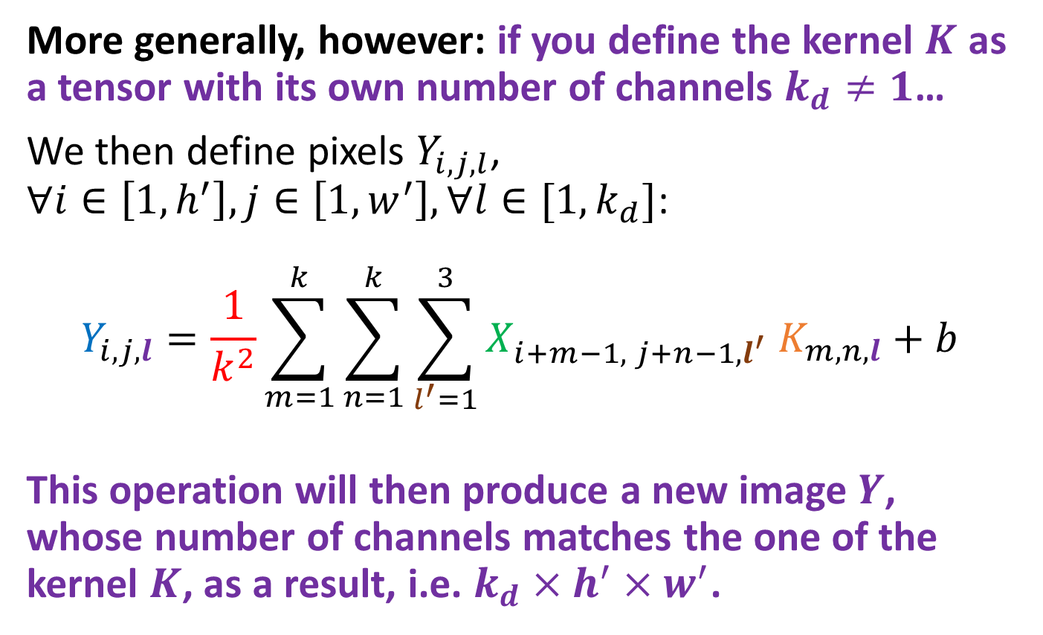

Convolution on high dim
1 | 2 | 4 | 2 | 1
4 | 7 | 3 | 2 | 1
4 | 5 | 2 | 3 | 1
2 | 1 | 7 | 8 | 4
3 | 2 | 4 | 7 | 8
1 | 2 | 4 | 2 | 1
4 | 7 | 3 | 2 | 1
4 | 5 | 2 | 3 | 1
2 | 1 | 7 | 8 | 4
3 | 2 | 4 | 7 | 8
1 | 2 | 4 | 2 | 1
4 | 7 | 3 | 2 | 1
4 | 5 | 2 | 3 | 1
2 | 1 | 7 | 8 | 4
3 | 2 | 4 | 7 | 8
$$X$$
More generally, however: if you define the kernel $K$ as a tensor with its own number of channels $k_{d}≠1$…
We then define pixels $Y_{i,j,l}$, $∀i∈\left[1, h^{′}\right], j∈\left[1,w^{′}\right], ∀l∈[1, k_{d}]$:
$$Y_{i,j,l}=\frac{1}{k^{2}}\sum_{m=1}^{k}{\sum_{n=1}^{k}{\sum_{l^{′}=1}^{3}{X_{i+m−1, j+n−1,l^{′}} K_{m,n,l}}}}+b$$
This operation will then produce a new image $Y$, whose number of channels matches the one of the kernel $K$, as a result, i.e. ${k_{d}×h}^{′}×w^{′}$.
1 | 0 | 1
0 | 2 | 1
1 | 0 | 1
1 | 0 | 1
0 | 2 | 1
1 | 0 | 1
$$K$$
1 | 0 | 1
0 | 2 | 1
1 | 0 | 1
$$…$$ | … | …
… | … | …
… | $$\frac{39}{9}$$ | …
$$…$$ | … | …
… | … | …
… | $$\frac{39}{9}$$ | …
$$Y$$
$$\frac{28}{9}$$ | … | …
… | … | …
… | $$\frac{39}{9}$$ | …

Slide 17
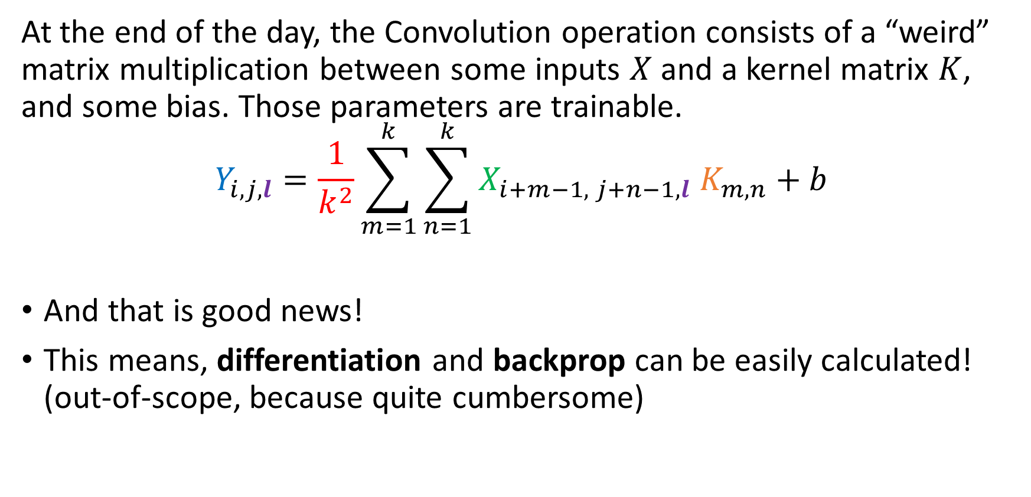
A quick word on backprop
At the end of the day, the Convolution operation consists of a “weird” matrix multiplication between some inputs $X$ and a kernel matrix $K$, and some bias. Those parameters are trainable.
$$Y_{i,j,l}=\frac{1}{k^{2}}\sum_{m=1}^{k}{\sum_{n=1}^{k}{X_{i+m−1, j+n−1,l} K_{m,n}}}+b$$
And that is good news!
This means, differentiation and backprop can be easily calculated! (out-of-scope, because quite cumbersome)

Slide 18
How to backprop in Conv (annoying, but possible)

Slide 19
How to backprop in Conv (annoying, but possible)
Not implementing the backprop for convolution (although we would be capable of doing it)!

Slide 20
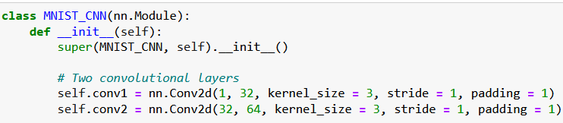
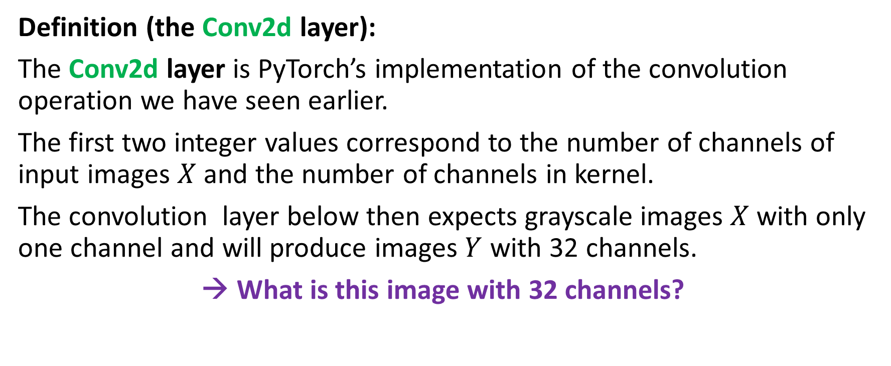
Conv2d layer
Definition (the Conv2d layer):
The Conv2d layer is PyTorch’s implementation of the convolution operation we have seen earlier.
The first two integer values correspond to the number of channels of input images $X$ and the number of channels in kernel.
The convolution layer below then expects grayscale images $X$ with only one channel and will produce images $Y$ with 32 channels.
→ What is this image with 32 channels?

Slide 21
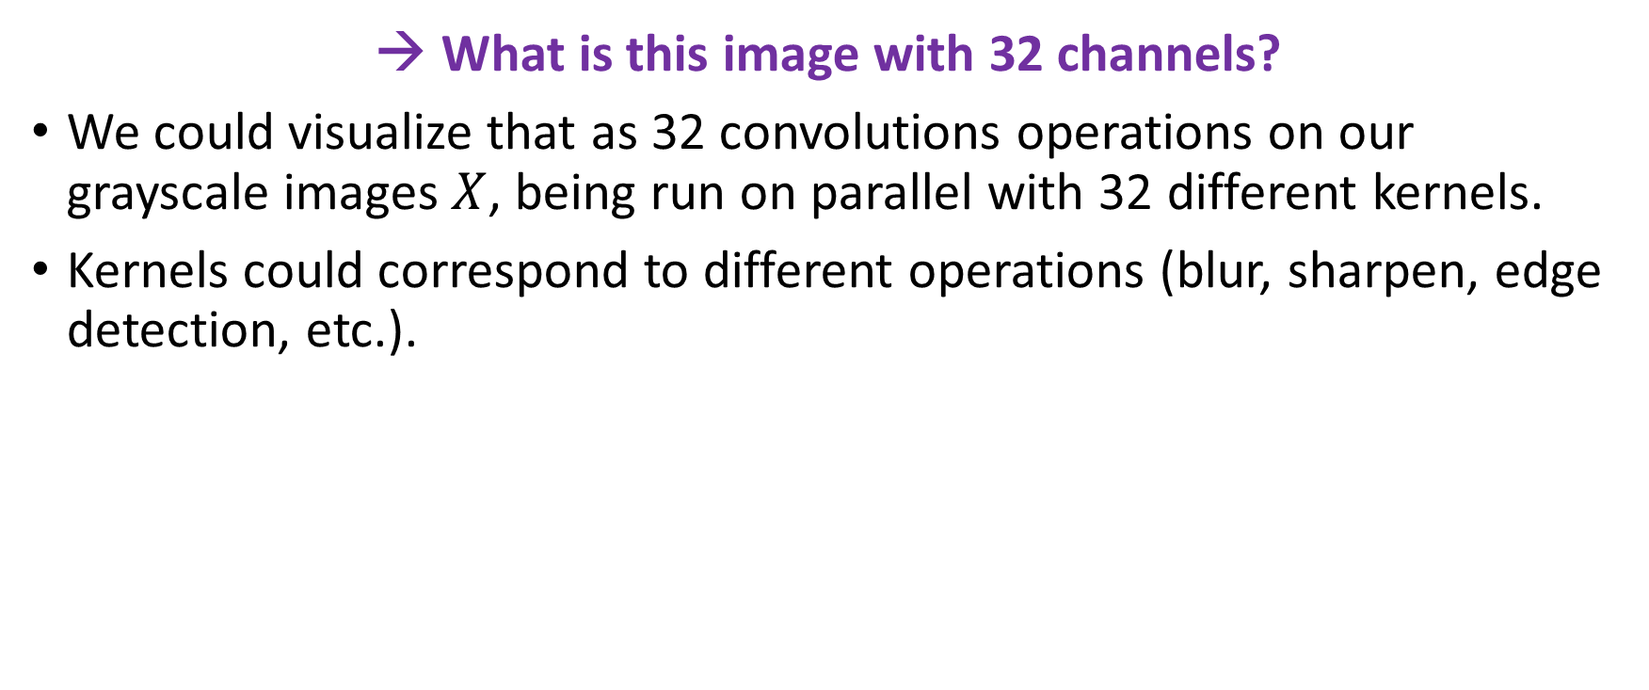
Convolution on high dim
→ What is this image with 32 channels?
We could visualize that as 32 convolutions operations on our grayscale images $X$, being run on parallel with 32 different kernels.
Kernels could correspond to different operations (blur, sharpen, edge detection, etc.).

Slide 22
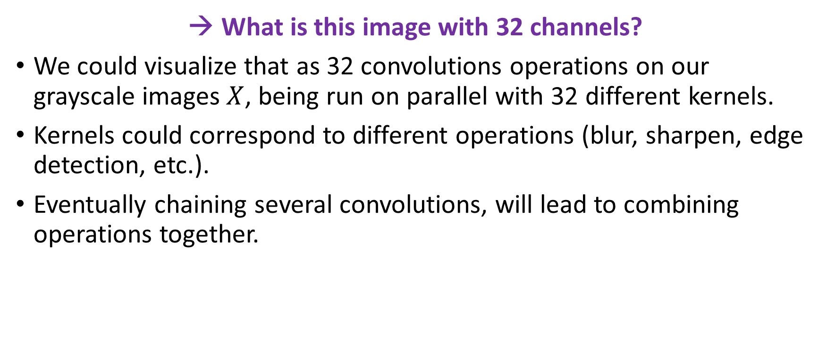
Chaining convolutions
→ What is this image with 32 channels?
We could visualize that as 32 convolutions operations on our grayscale images $X$, being run on parallel with 32 different kernels.
Kernels could correspond to different operations (blur, sharpen, edge detection, etc.).
Eventually chaining several convolutions, will lead to combining operations together.

Slide 23
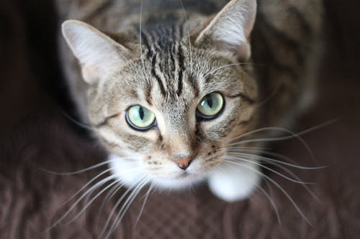
Chaining convolutions
For instance: recognizing a cat ear = two edge detections, then combined to recognize a triangular shape or some sort?

Slide 24
The core idea behind CNN
Definition (Convolutional Neural Networks):
Introduced in [LeCun1998], Convolutional Neural Networks (or CNNs in short) are Neural Networks which integrate convolutions as the processing operations to be used on input images, in place of the Linear ones.
Training a CNN is then equivalent to letting the Neural Network decide on which kernels values (and therefore which image processing operations) to use in the convolution operations run in both parallel and sequence.

Slide 25
Training a CNN
CNNs have shown much better performance at processing images data types, compared to Neural Networks implementing Linear operations.
For this reason, Convolutions (and CNNs) are indeed the preferred processing method when inputs are images.
In addition, as the convolution is “just another weird matrix multiplication of some sort”, this means that the trainable parameters (weight/kernel and bias) could be trained using the same backpropagation as earlier!
(We will however not implement it and rely on autograd!)

Slide 26
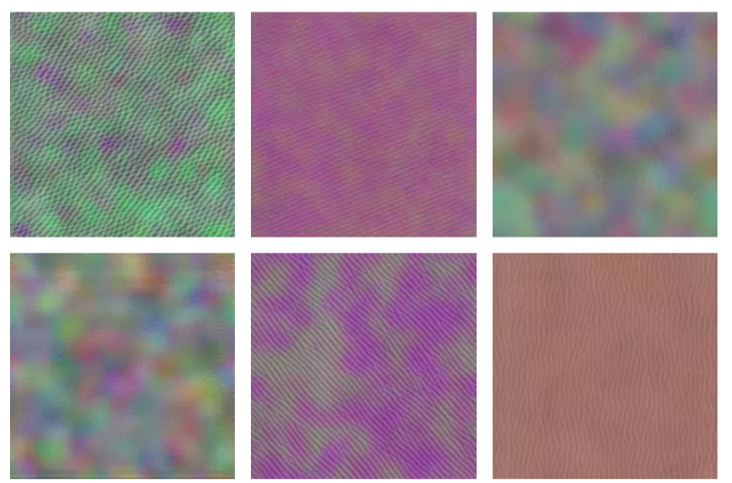
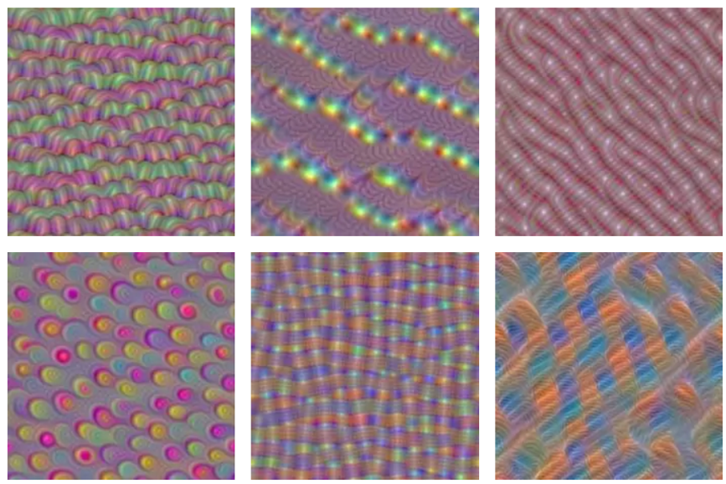
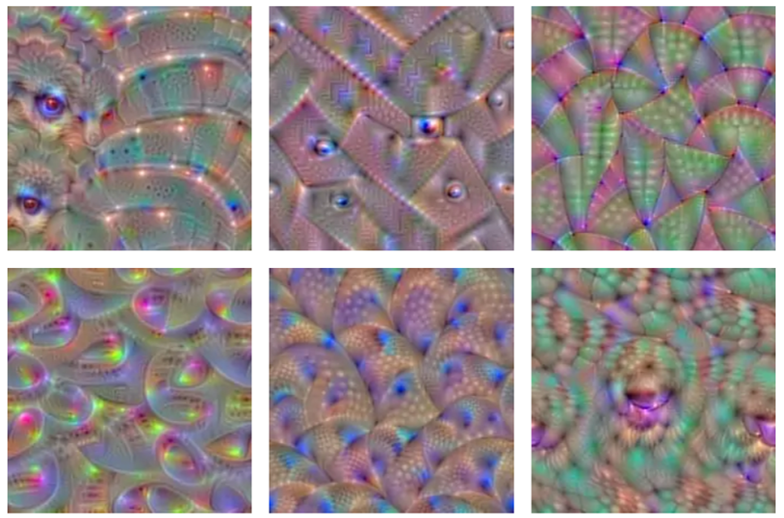
Chaining convolutions
Week 12-13 (explainability on CNNs): We will show during this W12-13 lecture how the first layers are typically implementing basic shapes and colors detection, whereas deeper layers are progressively recognizing more and more sophisticated patterns.

Slide 27
Our first CNN on MNIST
Using previous concepts and intuitions, we will therefore build our first Convolutional Neural Network (CNN).
This network will have the same logic as the previous DNN from last week, but it will replace the first few Linear layers with Conv2d operations instead.
By doing so, we are hoping that the CNN will be able to figure out which kernel values (and image processing operations) to use, for the MNIST classification task.

Slide 28
Our first CNN on MNIST
We will therefore build our first Convolutional Neural Network (CNN).
The final layers must however consist of Linear layers, whose purpose is to eventually produce a 1D vector of 10 values, consisting of the probabilities for each MNIST class.
Between the last Conv2d (which produces a 2D image) and the first fully connected vector (which expects a 1D vector), we will implement a flattening of the image, as before.

Slide 29
Our first CNN on MNIST
Our CNN: 2 Conv2d layers + Flatten + 2 Linear layers
Batch of 256 greyscale MNIST images (256, 1, 28, 28)
First Conv2d, with same padding (256, 32, 28, 28)
Second Conv2d, with same padding (256, 64, 28, 28)
Flatten in 1D vector (256, 50176)
First Linear Layer (256, 128)
Second Linear Layer (256, 10)

Slide 30
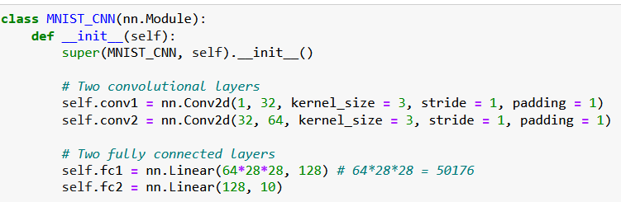
Our first CNN on MNIST
Our CNN: 2 Conv2d layers + Flatten + 2 Linear layers

Slide 31
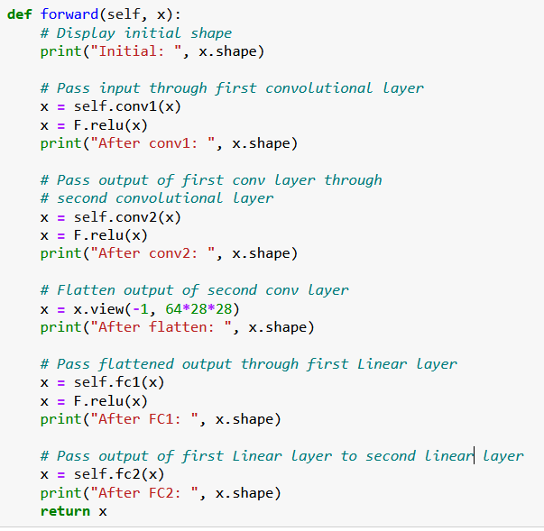
Our first CNN on MNIST
Our CNN: 2 Conv2d layers + Flatten + 2 Linear layers
Define the sequence of operations in the forward method as before.
Good practice: We will print the shape of each layer output to confirm sizes produced by each layer.
Also, ReLU seems to work well as an activation with images (NFL!).

Slide 32
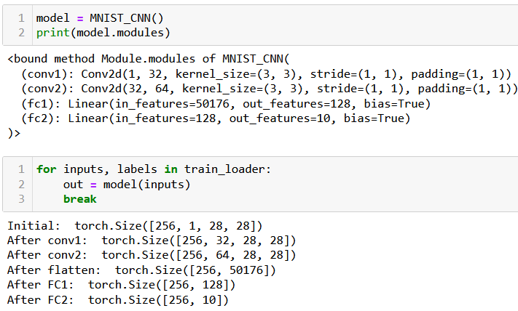
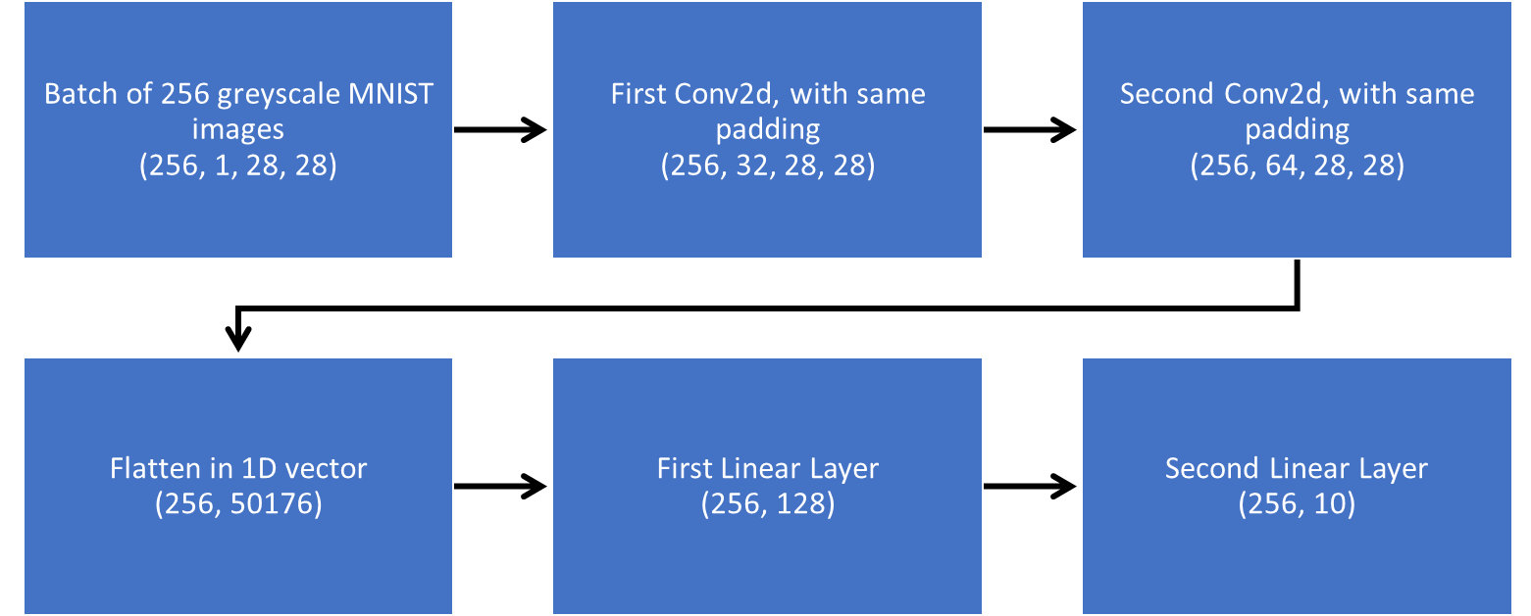
Our first CNN on MNIST
Good practice: We will show the modules/layers in our CNN, and print the shape of each layer output to confirm sizes produced by each layer.

Slide 33
Writing a trainer function for CNNs
As before, we need a trainer and evaluation function for our Convolution Neural Network model.
We will be using a stochastic mini-batch Adam optimizer, like before.
Loss is cross-entropy, like before.
We will keep track of the train/test losses, train/ test accuracies, and display them in training performance curves later.
Over a given number of iterations, using the power of the backward() and optimizer.step() methods to update parameters automatically for us in all the Conv2d and Linear layers.
We will then set the model on eval mode and compute losses and accuracies on the testing set, one final time.

Slide 34
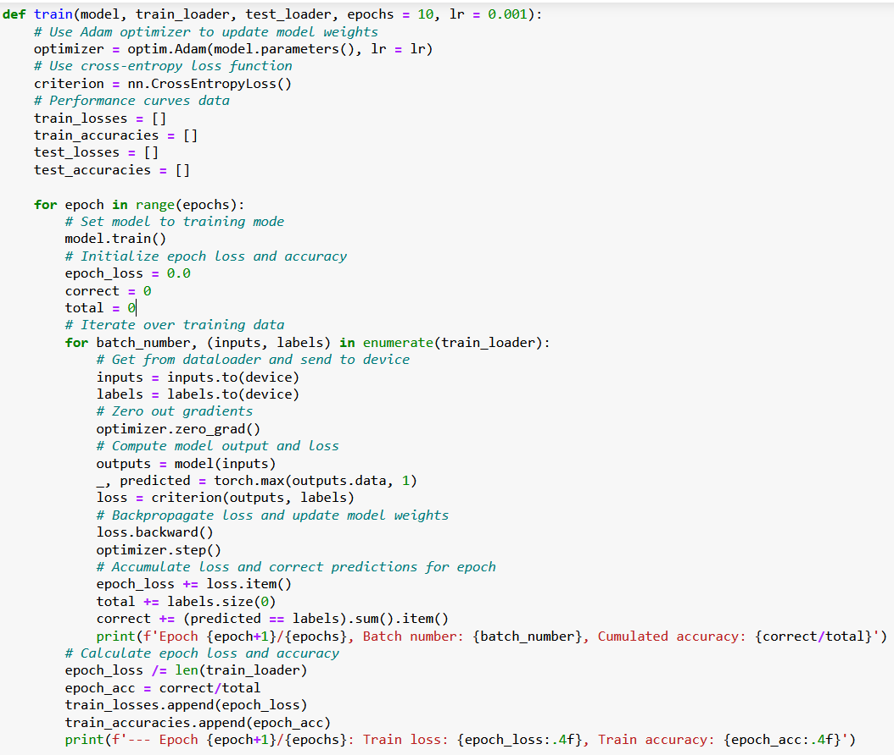
Trainer/Eval function (setup)

Slide 35
Trainer/Eval function (training part)

Slide 36
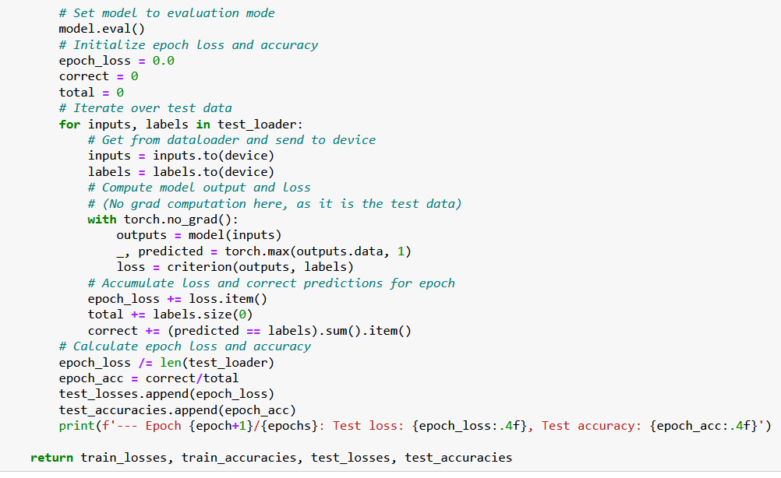
Trainer/Eval function (evaluation part)

Slide 37
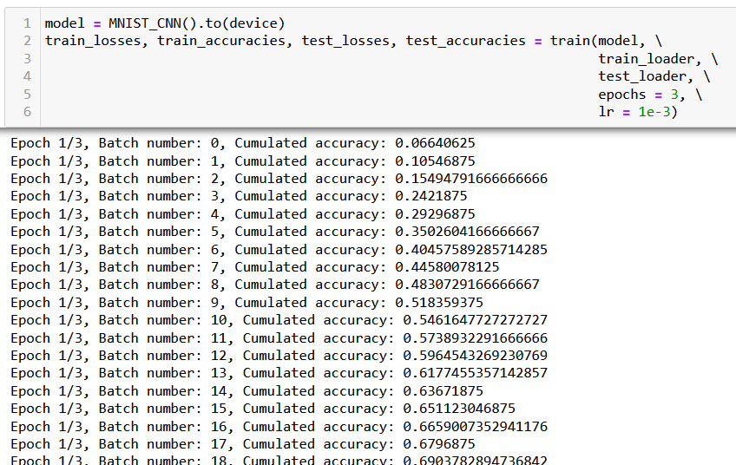
Trainer/Eval function (running)

Slide 38
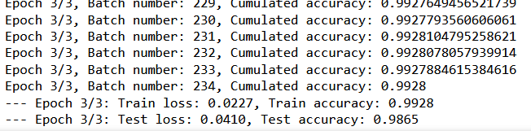
Trainer/Eval function (running)
In only three iterations, we have managed to achieve a higher accuracy than the equivalent Linear model with more layers that we have trained last week for almost 1000 iterations…!
Confirmed!
CNNs and Convolution operations are indeed better than Linear operations when it comes to processing images!

Slide 39

Congratulations, you just recreated what Yann LeCun did in 1989 when he created CNNs!

Slide 40
Pooling layers
Definition (pooling layers):
A pooling layer in a CNN is a down-sampling operation that strongly reduces the spatial dimensions (width and height) of the successive images or feature maps, while retaining the important information.
The purpose of pooling is to reduce the computation and memory required by the network, as well as to increase the invariance of the features with respect to small translations (from the same paper, [LeCun1998]).
A pooling layer, like the flattening operation, does not have any trainable parameters, and is therefore not a trainable layer.

Slide 41
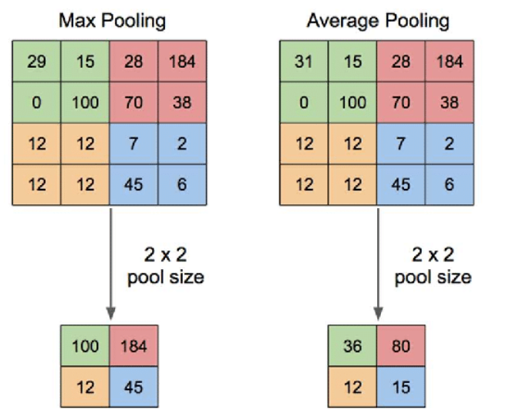
Types of pooling layers
In PyTorch, there are different types of pooling layers, all worth trying, including:
Max pooling: Selects the maximum value from the window,
Average pooling: Takes the average of all values,
Sum pooling: Takes the sum of all values in the window.
Etc.

Slide 42
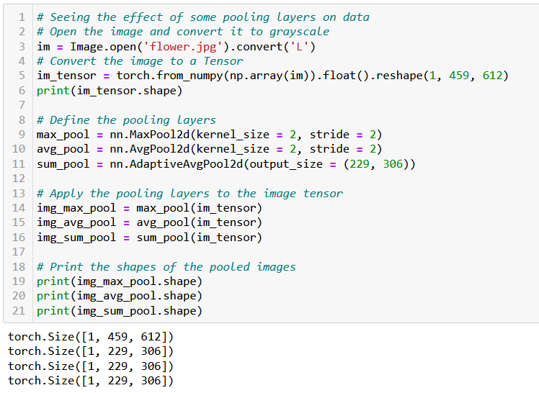
Types of pooling layers

Slide 43
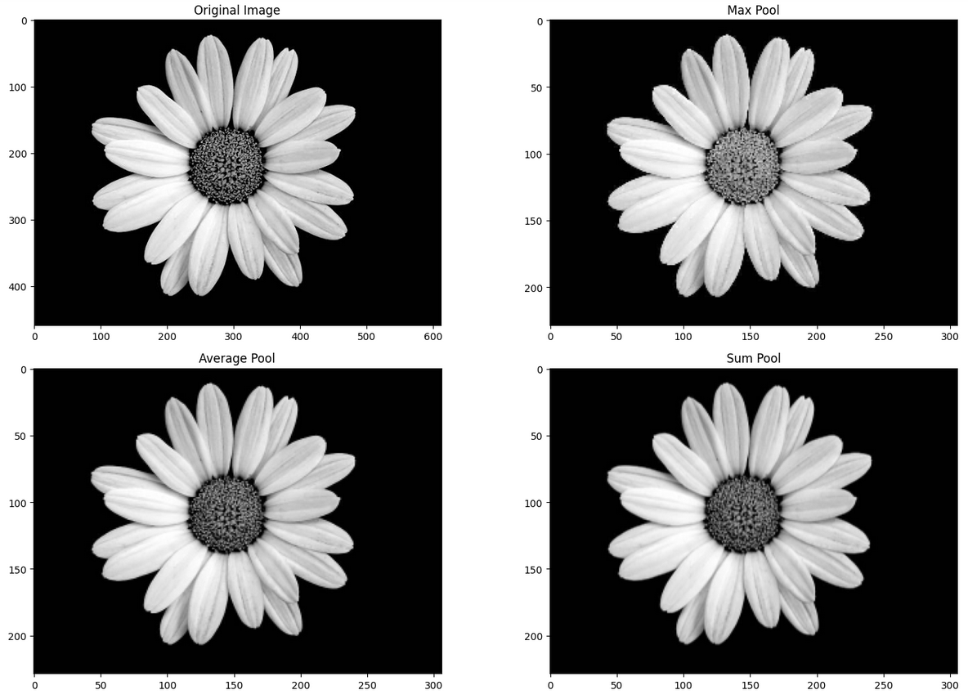

Slide 44
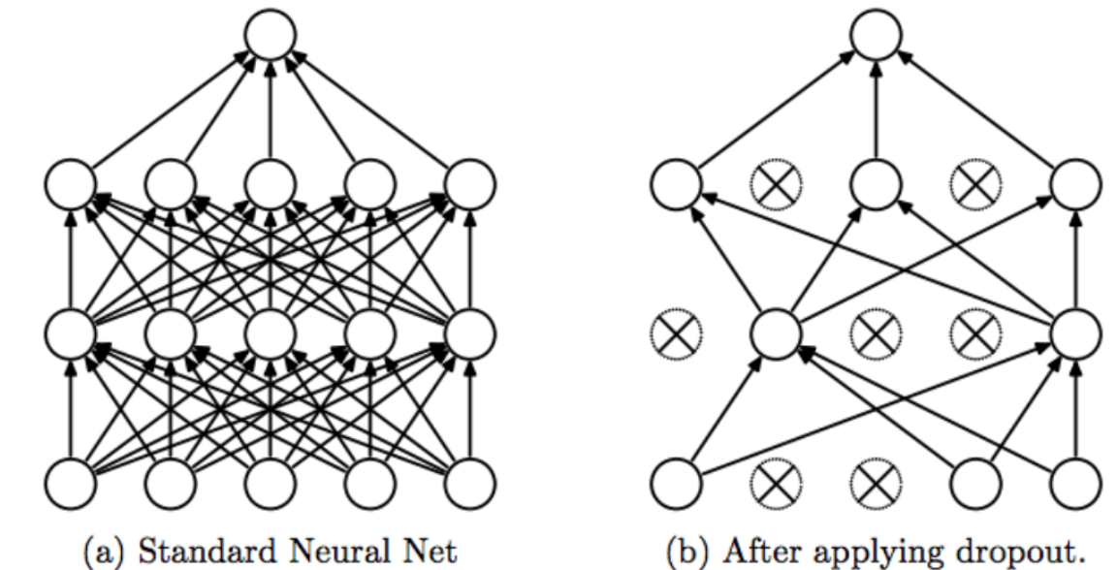
Dropout layers
Definition (dropout layers):
Introduced in [Srivastava2014], the dropout layer is a regularization technique used in deep learning to prevent overfitting.
The dropout layer randomly drops out, or sets to zero, some of the neurons in the network during each training iteration.

Slide 45
Dropout layers
Definition (dropout layers):
Introduced in [Srivastava2014], the dropout layer is a regularization technique used in deep learning to prevent overfitting.
The dropout layer randomly drops out, or sets to zero, some of the neurons in the network during each training iteration.

Slide 46
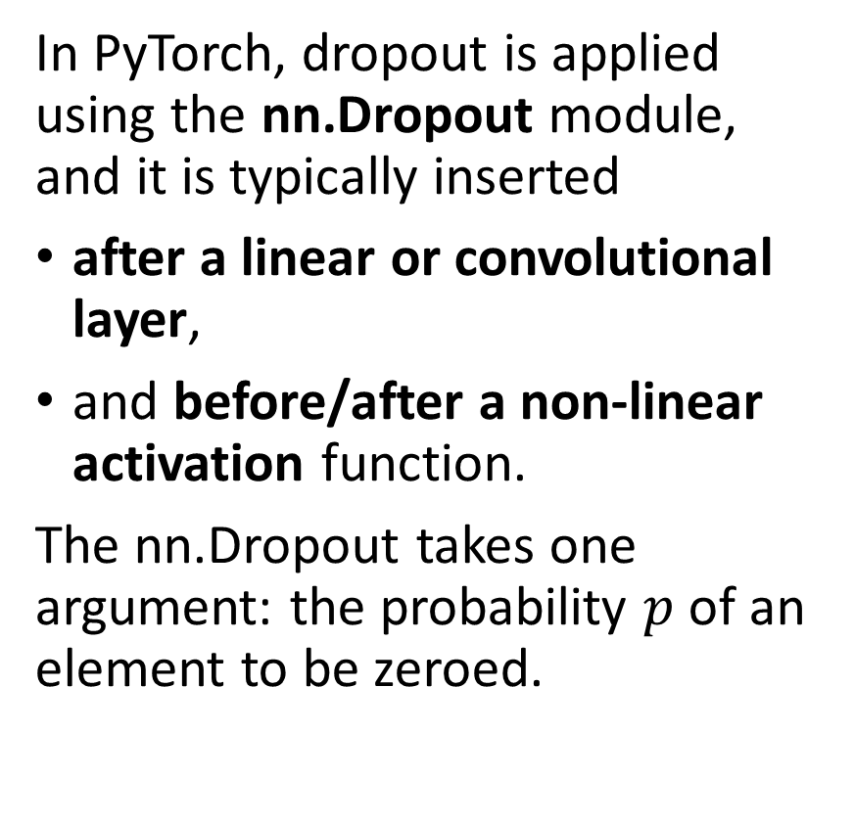
Dropout layers
Definition (dropout layers):
Introduced in [Srivastava2014], the dropout layer is a regularization technique used in deep learning to prevent overfitting.
The dropout layer randomly drops out, or sets to zero, some of the neurons in the network during each training iteration.
In PyTorch, dropout is applied using the nn.Dropout module, and it is typically inserted
after a linear or convolutional layer,
and before/after a non-linear activation function.
The nn.Dropout takes one argument: the probability $p$ of an element to be zeroed.

Slide 47
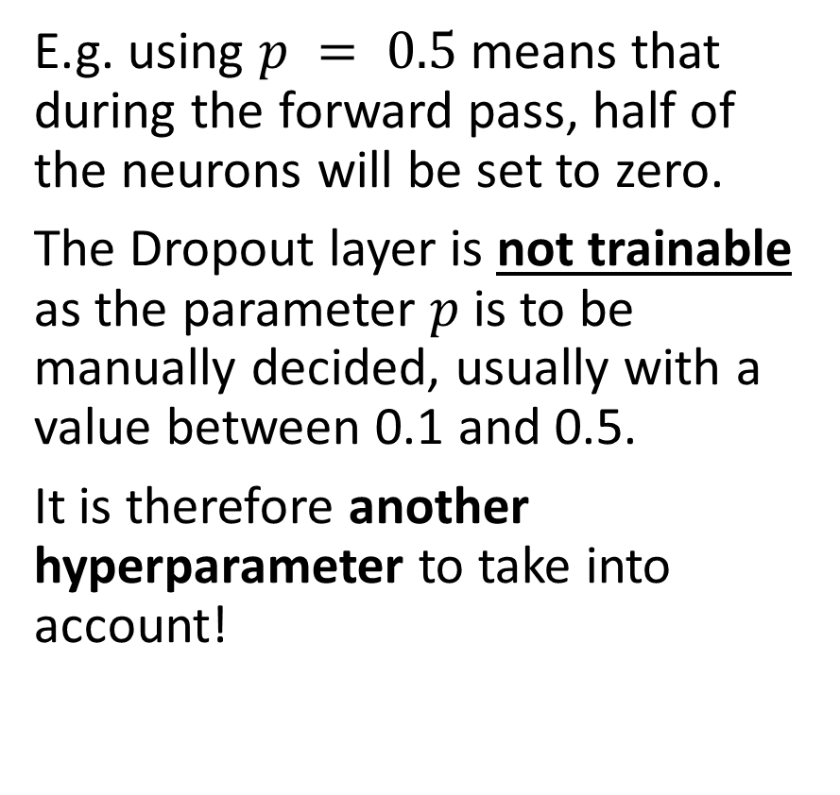
Dropout layers
E.g. using $p = 0.5$ means that during the forward pass, half of the neurons will be set to zero.
The Dropout layer is not trainable as the parameter $p$ is to be manually decided, usually with a value between 0.1 and 0.5.
It is therefore another hyperparameter to take into account!

Slide 48
A very important note, however: Dropout is the first operation we see to have two different behaviours.
During training mode (i.e. when model is set to train() mode), the dropout layer randomly drops out a specified portion of the neurons, as said earlier.
During evaluation mode (i.e. when model is set to eval() mode), it does not drop out any neurons anymore. Instead, it passes all activations from the previous layer to the next layer in the network, in an attempt to maximize performance on the test set.

Slide 49
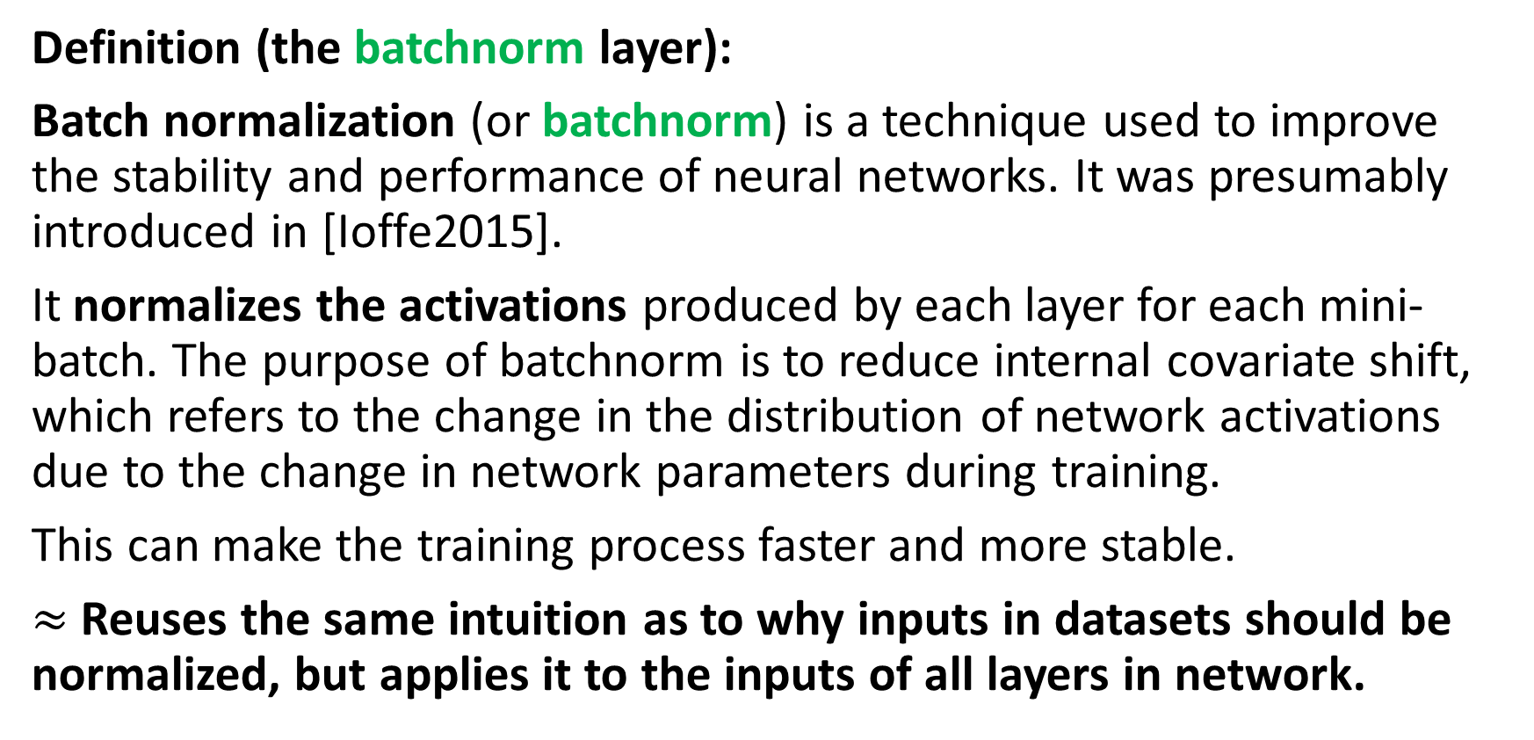
Batchnorm layer
Definition (the batchnorm layer):
Batch normalization (or batchnorm) is a technique used to improve the stability and performance of neural networks. It was presumably introduced in [Ioffe2015].
It normalizes the activations produced by each layer for each mini-batch. The purpose of batchnorm is to reduce internal covariate shift, which refers to the change in the distribution of network activations due to the change in network parameters during training.
This can make the training process faster and more stable.
$≈$ Reuses the same intuition as to why inputs in datasets should be normalized, but applies it to the inputs of all layers in network.

Slide 50
Batchnorm layer
In PyTorch, batchnorm can be applied to a layer using the nn.BatchNorm2d or nn.BatchNorm1d module, depending on whether the data is 1D shaped (output of a linear layer) or 2D shaped (e.g. image output of a Convolutional layer)
Like the dropout, the module should be inserted
after a linear or convolutional layer in the network,
and before the non-linear activation function.
The batchnorm layer takes one argument: the number of channels in the output of the previous layer.

Slide 51
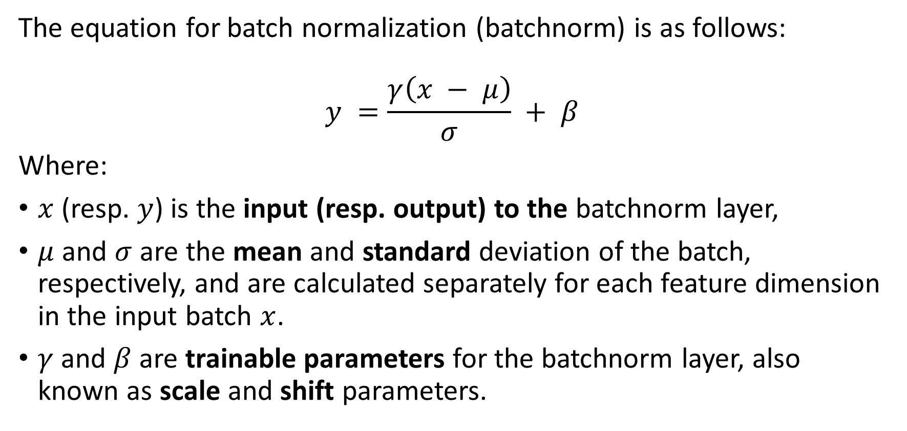
Normalization in BatchNorm
The equation for batch normalization (batchnorm) is as follows:
$$y =\frac{γ\left(x − μ\right)}{σ} + β$$
Where:
$x$ (resp. $y$) is the input (resp. output) to the batchnorm layer,
$μ$ and $σ$ are the mean and standard deviation of the batch, respectively, and are calculated separately for each feature dimension in the input batch $x$.
$γ$ and $β$ are trainable parameters for the batchnorm layer, also known as scale and shift parameters.

Slide 52
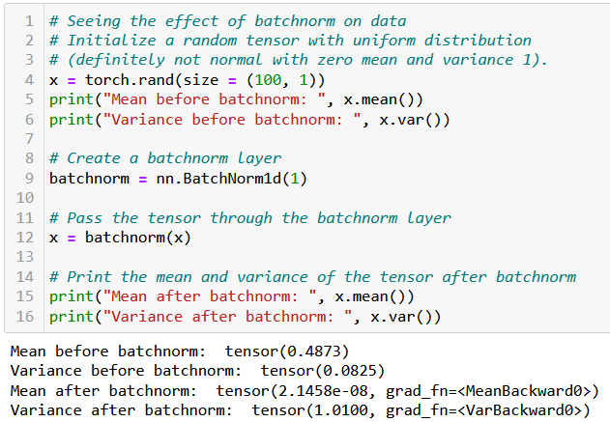
Normalization in BatchNorm

Slide 53
About BatchNorm behaviours
Important: BatchNorm, just like Dropout has two different behaviours in train and eval modes.
When the network is in training mode, the batch normalization layer updates its mean and variance estimates based on the current mini-batch of data. During the forward pass, it applies the normalization based on these mean and variance estimates.
When the network is in evaluation mode, the batch normalization layer uses the mean and variance estimates previously calculated during training to normalize the activations. This ensures that the activations are normalized in the same way during training and evaluation.

Slide 54
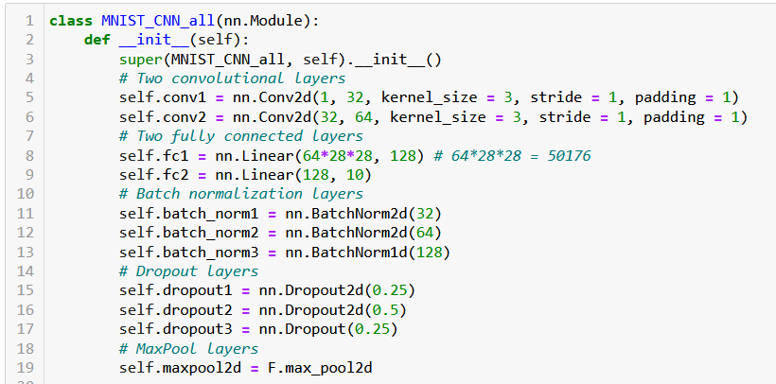
Implementing all layers in our CNN
Let us first define BatchNorm, dropout and MaxPool layers in __init__.
Arbitrarily fixing the dropout probabilities (should be hyperparameter?).

Slide 55
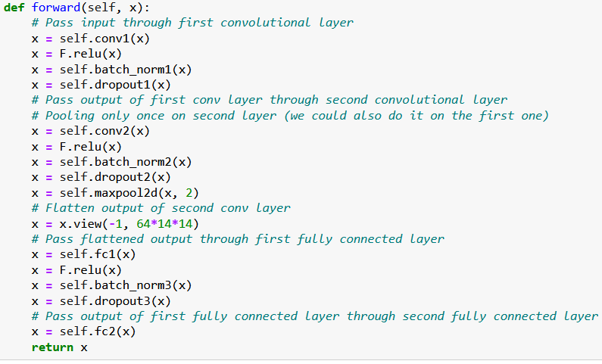
Implementing all layers in our CNN
Using each layer in correct sequence of the forward() method.
Also, one MaxPool layer after last Conv2d.
Note: 64*14*14 instead of the previous 64*28*28 in Flatten due to MaxPool.

Slide 56
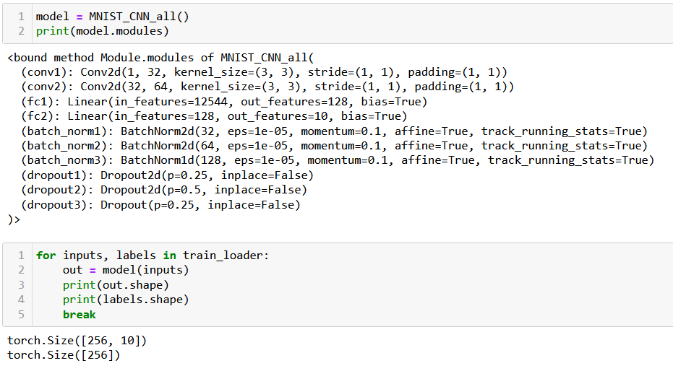
Implementing all layers in our CNN

Slide 57
A final note
The Dropout, BatchNorm and Pooling layers have been introduced in the Computer Vision field.
However, these days, every other field of Deep Learning (e.g. Natural Language Processing) is reusing them in their own models.
Important lesson: you might not necessarily be interested in Computer Vision, but you should still consider learning about it, as many intuitions and tools could be reused in other problems.

Slide 58
Learn more about these topics
Out of class, supporting papers, for those of you who are curious.
[LeCun1998] Y. LeCun, L. Bottou, Y. Bengio, and P. Haffner, “Gradient-Based Learning Applied to Document Recognition”, 1998.
[Srivastava2014] N. Srivastava, G. Hinton, A. Krizhevsky, I. Sutskever, and R. Salakhutdinov, “Dropout: A Simple Way to Prevent Neural Networks from Overfitting”, 2014.
[Ioffe2015] S. Ioffe and C. Szegedy, “Batch Normalization: Accelerating Deep Network Training by Reducing Internal Covariate Shift”, 2015.

Slide 59
Learn more about these topics
Tracking important names (Track their works and follow them on Scholar, Twitter, or whatever works for you!)
Nitish Srivastava: Researcher at Google. https://scholar.google.com/citations?user=s1PgoeUAAAAJ&hl=fr https://nitish2112.github.io/
Alex Krizhevsky: Former researcher at Google. Now works for a company called Dessa, and University of Toronto. https://scholar.google.com/citations?user=xegzhJcAAAAJ&hl=fr

Slide 60
Learn more about these topics
Tracking important names (Track their works and follow them on Scholar, Twitter, or whatever works for you!)
Ilya Sutskever: Co-founder and Chief Scientist at OpenAI. https://scholar.google.com/citations?user=x04W_mMAAAAJ&hl=en https://www.cs.toronto.edu/~ilya/
Ruslan Salakhutdinov: Professor at Carnegie Mellon University. https://scholar.google.co.uk/citations?user=ITZ1e7MAAAAJ&hl=en https://www.cs.cmu.edu/~rsalakhu/

Slide 61
Learn more about these topics
Tracking important names (Track their works and follow them on Scholar, Twitter, or whatever works for you!)
Sergey Ioffe: Researcher at Google Brain. https://scholar.google.com/citations?user=3QeF7mAAAAAJ&hl=en https://research.google/people/ChristianSzegedy
Christian Szegedy: Researcher at Google Brain. https://scholar.google.com/citations?user=S5zOyIkAAAAJ&hl=en https://research.google/people/SergeyIoffe/

Slide 62
Learn more about these topics
Out of class, extra reading, for those of you who are curious.
[TDS20] “Gentle Dive into Math Behind Convolutional Neural Networks“, on Towards Data Science, 2019. A good article with great visuals to better understand convolution. https://towardsdatascience.com/gentle-dive-into-math-behind-convolutional-neural-networks-79a07dd44cf9

